Slide 1
Structured Analytics Near real-time & Big Data
Taras Bachynskyy
2013

Slide 2
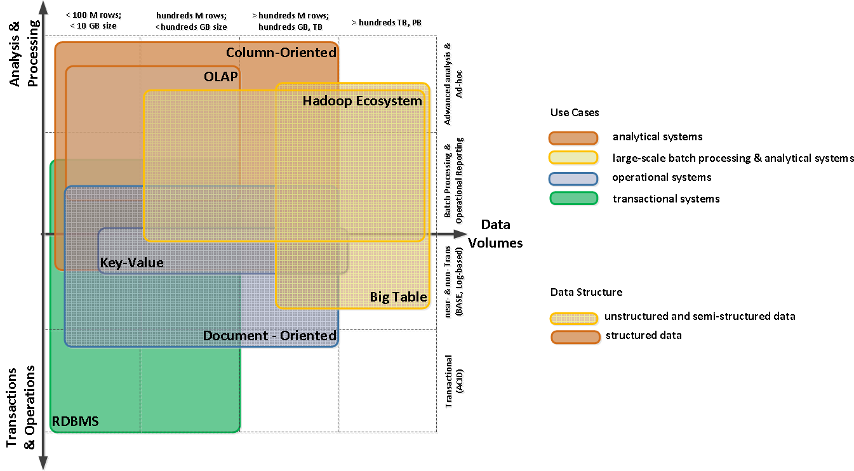
Big Picture

Slide 3
Big Picture

Slide 4
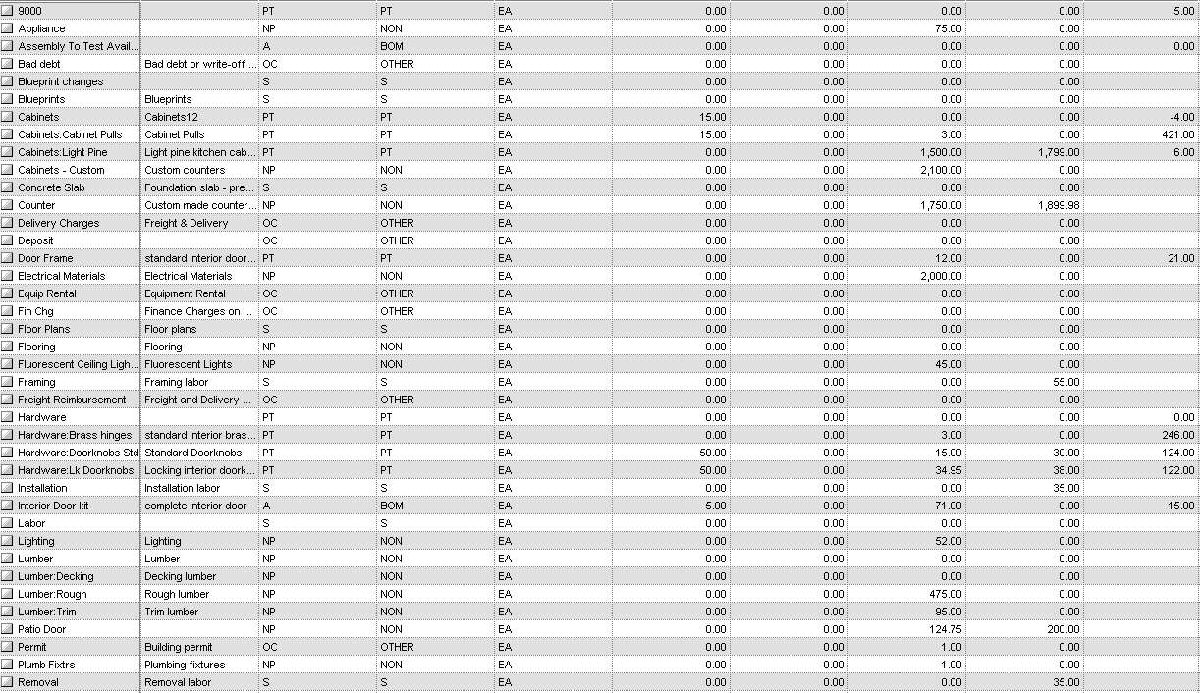
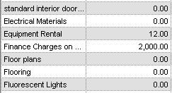
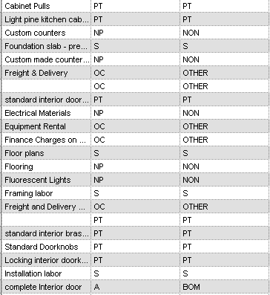

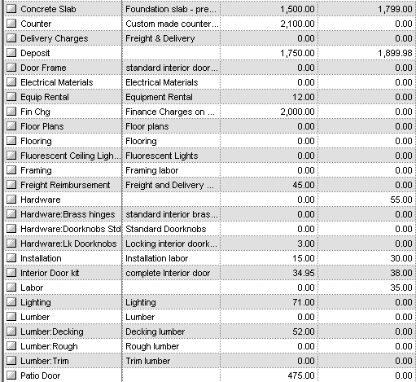
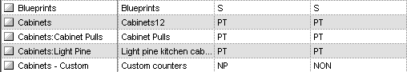
Data processing and Analysis traditional approach
no aggregates:
performance issue
ETL
transactions
ETL
with aggregates:
no ad-hoc capabilities
ETL
1
incremental data
2
historical data

Slide 5
Data processing and Analysis traditional approach
reporting limited by cube design
ETL
transactions
ETL
ETL
1
incremental data
2
historical data
3
aggreagated data

Slide 6
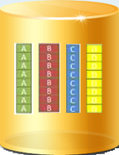
Data processing and Analysis modern approach
column oriented storage
massively parallel processing
transactions
Near real time data processing
ad-hoc capabilities
MOM
workers

Slide 7
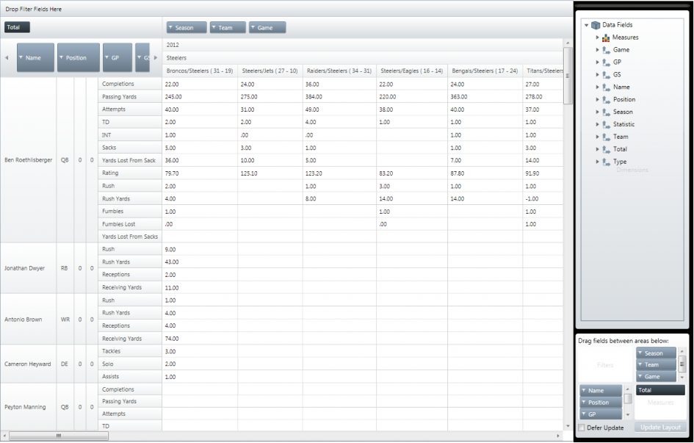
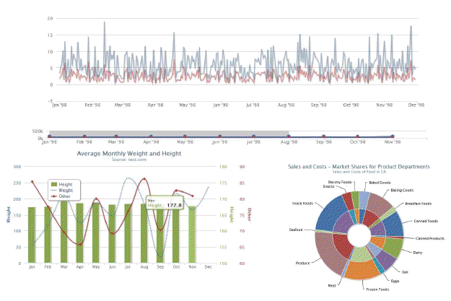
Data processing and Analysis modern approach
self-service
highly granular view
reporting platform
Customer
Product
Sales
Date
Branch
semantic model

Slide 8
Technology Stack
Message Oriented Middleware
RabbitMQ
Amazon SQS
Distributed Tasks Middleware
Celery
Databases
Amazon Redshift (column-oriented database + Amazon RDS (MySQL RDBMS)

Slide 9
Reference Architecture

Slide 10

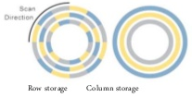
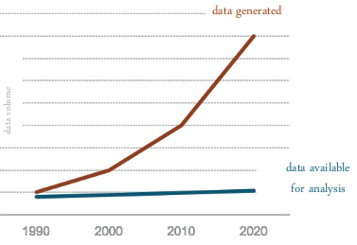
Amazon Redshift
Inexpensive
$999 per 1 TB of compressed data per 1 year
optimized for DW
I/O intensive workload
data compression
fast
PB-scale
Columnar storages on premise
HP Vertica
ParAccel

Slide 11
Scalability

Slide 12
Data Growth traditional approach
limited to ~250 million rows
depends on technology platform
ETL
scale
scale
ETL
scale
ETL
1
incremental data
2
historical data
3
aggreagated data

Slide 13


Data Growth traditional approach
Practically not supported!
manipulations with connection strings or TCP/IP load balancers are not ‘scale-out’ solutions
ETL
ETL
scale out
scale out
scale out
ETL
1
incremental data
2
historical data
3
aggreagated data

Slide 14
Data Growth modern approach
column oriented storage
massively parallel processing
Petabyte scale !
scale out
scale out
scale out
MQ
workers

Slide 15
Information Delivery pull model vs. push model

Slide 16

Information Delivery pull model
limited maintenance window

Slide 17
Information Delivery push model
push model !

Slide 18
Data Processing
Consolidation
Cleansing
Validation
Pre-processing
Lookup
Surrogate keys !

Slide 19
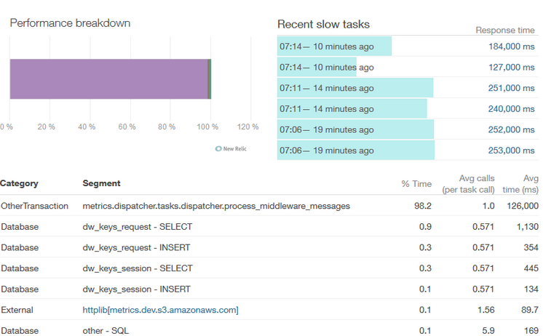
Performance

Slide 20
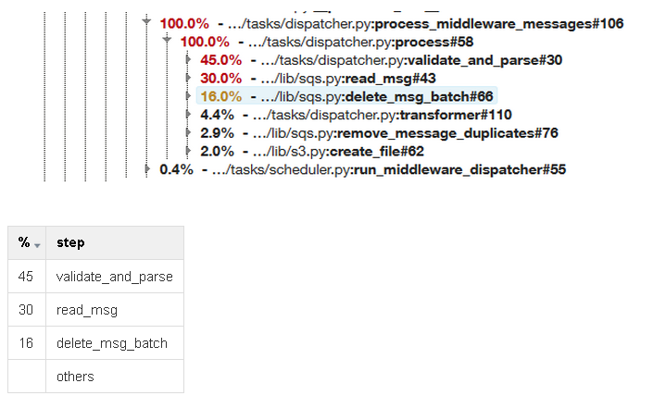

Slide 21
 | Traditional Approach | Modern Approach
Self-Service and Ad-Hoc Capabilities | limited by DW or Cube: reporting Platform ad-hoc capabilities are restricted by cube design issues with leaf-level calculations no ad-hoc capabilities in case of aggregated tables | No limits on the DW level: maximizes the exploitation of Reporting Platform’s features highly granular analysis
Extensibility and SDLC | any functional change requires a number of changes in the ETL, Staging, DW and OLAP Cube | Only workers (tasks) and DW structure should be changed
Maintainability | limited maintenance window, complex data processing flow | Simplified maintenance and data flow
Scalability | Scale-in: limited to ~250 million rows. depends on technology platform Scale-out: not supported. (manipulations with connection strings or TCP/IP load balancers) | Scale-out is supported on each level (MOM, Workers, DW) DW supports up to Petabytes
Near real-time | not supported in the DW. Real-time data could be obtained directly from transaction system only | Push model and database cluster allows near real-time analysis
Cross-systems Data Consolidation | ETL and Staging data processing | You cannot consolidate heterogonous systems on the “event” level
Information Delivery Model | Pull Model | Push Model

Slide 22
Questions?

